Slide 1
Serverless Application Model
In Amazon Web Services

Slide 2
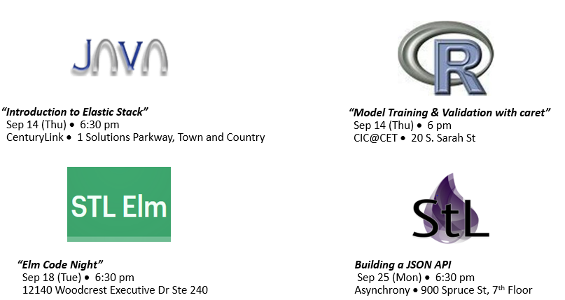
What’s Around Us….

Slide 3
The problem with Servers ...
Cost
Administration
Context
Problem statement
Effort and Speed
To use an EC2 VM to host a web application is going to require that you have at least one host always on. So a t2.micro is going to run at least $8/month. And that is a garbage web server.
Any hosts you run are going to require administration of some sort. How do you ensure your web server is running and responding correctly to requests? Scaling Policies? Patching?
Ultimately, I believe that the Hosted approach to application design can be a real impediment to you Full Stack Developers.

Slide 4
Solution
S3 hosts HTML and JS Content
Route 53 Manages Domain and SSL Certificates
CloudFront “Fronts” S3 Bucket with Your Specific Domain
API Gateway produces Client API to connect app to Data
Lambda is Invoked By API Gateway to retrieve data from DynamoDB or S3.
Delegate to AWS

Slide 5
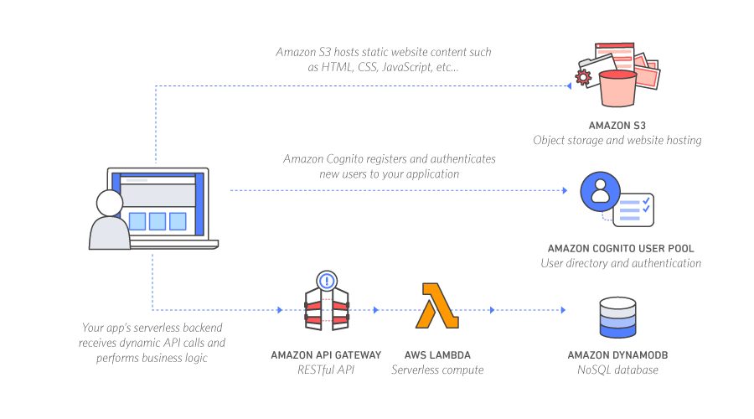
Design Graphic

Slide 6
Solving the Cost Problem .. My August 2017 Bill
AWS Service Charges August 2017 $1.12
Itemized:
API Gateway Request - 67,867 $0.24
AWS Lambda Compute 4,780.638 Second $0.00
AWS Lambda Requests 33,908 Requests $0.00
AWS Route 53 1 HostedZone $0.50
AWS S3 35,852 PUT/POST Requests $0.18
AWS S3 349,736 GET Requests $0.14

Slide 7
Solving the Administration Problem
No EC2, no servers to administer/patch/scale!
No VPC to Manage!
Limit your Attack Surface!
No Logging to manage!
Difficult CloudFormation!
Lambda Executes Server Side Code!
AWS SDK/ API Gateway Manages Integration!
Security scoped to Lambda Function!
Lambda Auto Logs to CloudWatch!
Simpler CloudFormation!

Slide 8
Increasing Application Development Velocity … Backend
Node.js drastically increases your velocity for writing database CRUD. I utilize an npm library called S3-DB to treat S3 as a database. https://www.npmjs.com/package/s3-db
API Gateway Integration with Lambda makes it trivial to invoke Lambda functions via API calls. Easily testable through Console!
CF Components are just Lambda and API Gateway

Slide 9
Increasing Application Development Velocity … Frontend
Easy to deploy application. You are simply uploading bundled files to S3.
CloudFront makes it easy to create “Domain Hosts” and tie them to your S3 App Distributions. To avoid CORS (Cross Origin Resource Sharing) you need to utilize CloudFront with a Route53 purchased Domain.
CF Components are just S3, Cognito, and CloudFront. Route53 Domains must be purchased through AWS console

Slide 10
Implementation
My Implementation of AWS SAM (Serverless Application Model) is based on the reference architecture published by the AWS Labs team : https://github.com/awslabs/lambda-refarch-webapp
My Source Code can be found at :
https://github.com/benMain/PointsAppServerlessFrontend
https://github.com/benMain/PointsAppServerlessBackend

Slide 11
Application
https://pointsapp.gainesvillesaddleclub.org/
Points Tracking Application for Saddle Club in Gainesville, Missouri. My Mother runs the local Saddle Club in my small hometown. She needed a way to publicly track points during the Horse Show competitions, and to let competitors see their show performance and year-to-date performance.

Slide 12
Application Walkthrough ...
React App: https://github.com/benMain/PointsAppServerlessFrontend
API Gateway: https://us-west-2.console.aws.amazon.com/apigateway/home?region=us-west-2#/apis/uzgezruwda/resources/nm76wgafh5
Lambda: https://us-west-2.console.aws.amazon.com/lambda/home?region=us-west-2#/functions

